Slide 1
Example Data Model RDF
Individual: EDAC-Environmental-Datasets
Types:
elsewebdata:WCSCoverageSet
Facts:
dcat:dataset <http://ontology.cybershare.utep.edu/ELSEWeb/data/coverages.owl#349396_dataset>,
dcat:dataset <http://ontology.cybershare.utep.edu/ELSEWeb/data/coverages.owl#349399_dataset>,
dcat:dataset <http://ontology.cybershare.utep.edu/ELSEWeb/data/coverages.owl#349397_dataset>,
dcat:dataset <http://ontology.cybershare.utep.edu/ELSEWeb/data/coverages.owl#349395_dataset>,
dcat:dataset <http://ontology.cybershare.utep.edu/ELSEWeb/data/coverages.owl#349398_dataset>
Individual: <http://ontology.cybershare.utep.edu/ELSEWeb/data/coverages.owl#349399_dataset>
Types:
elsewebdata:WCSCoverageDataset
Facts:
prov:wasGeneratedBy <http://ontology.cybershare.utep.edu/ELSEWeb/data/coverages.owl#349399_measurement>,
terms:temporal duration_0,
terms:spatial region_0,
dcat:distribution <http://ontology.cybershare.utep.edu/ELSEWeb/data/coverages.owl#349399_distribution>,
elsewebdata:hasID 349399

Slide 2
ELSEWeb meets SADI

Slide 3
Outline
Modeling and the Chihuahuan Desert
Understanding ELSEWeb and the Model Web
Enabling Discovery through ontologies
Enabling Transformation through SADI
Service Orchestration through SHARE
Making sense of it all through provenance

Slide 4
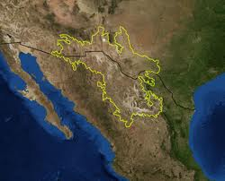
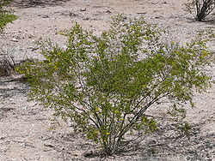
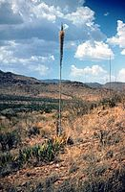
Use Case: Chihuahuan Desert Encroachment
Region: Northern Mexico, West Texas and Southern New Mexico
Terrain: Basins and Mountain Ranges
Climate: Mild Summer (35 – 40° C)
Flora:
Larrea Tridentata
Observation: Over the past 100 years, the Chihuahuan desert has encroached on existing grasslands, resulting in altered erosion patterns and thus an altered landscape.
Agave lechuguilla
Notes:
More informative title!!!! For example: the semantics of the scientific question

Slide 5
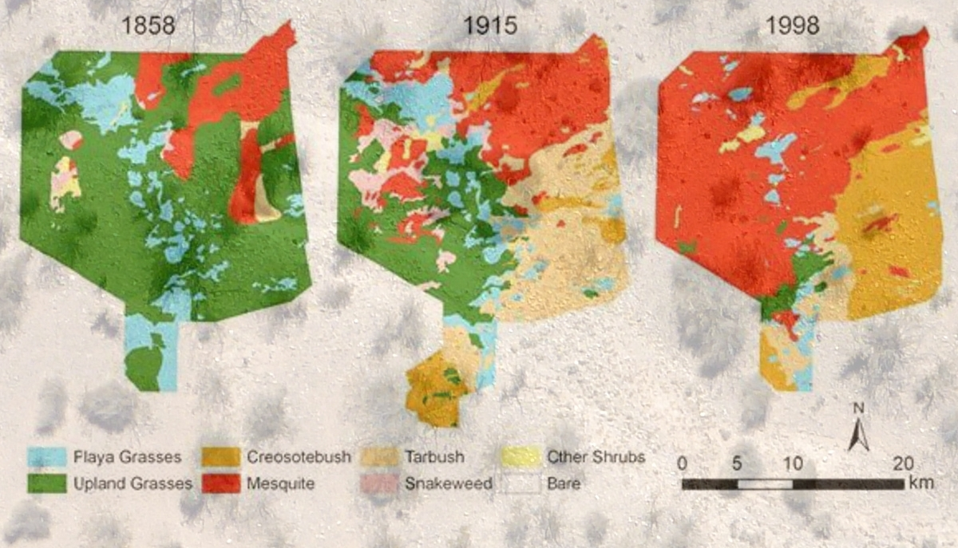
Transition from Grassland to Desert

Slide 6
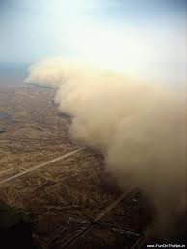
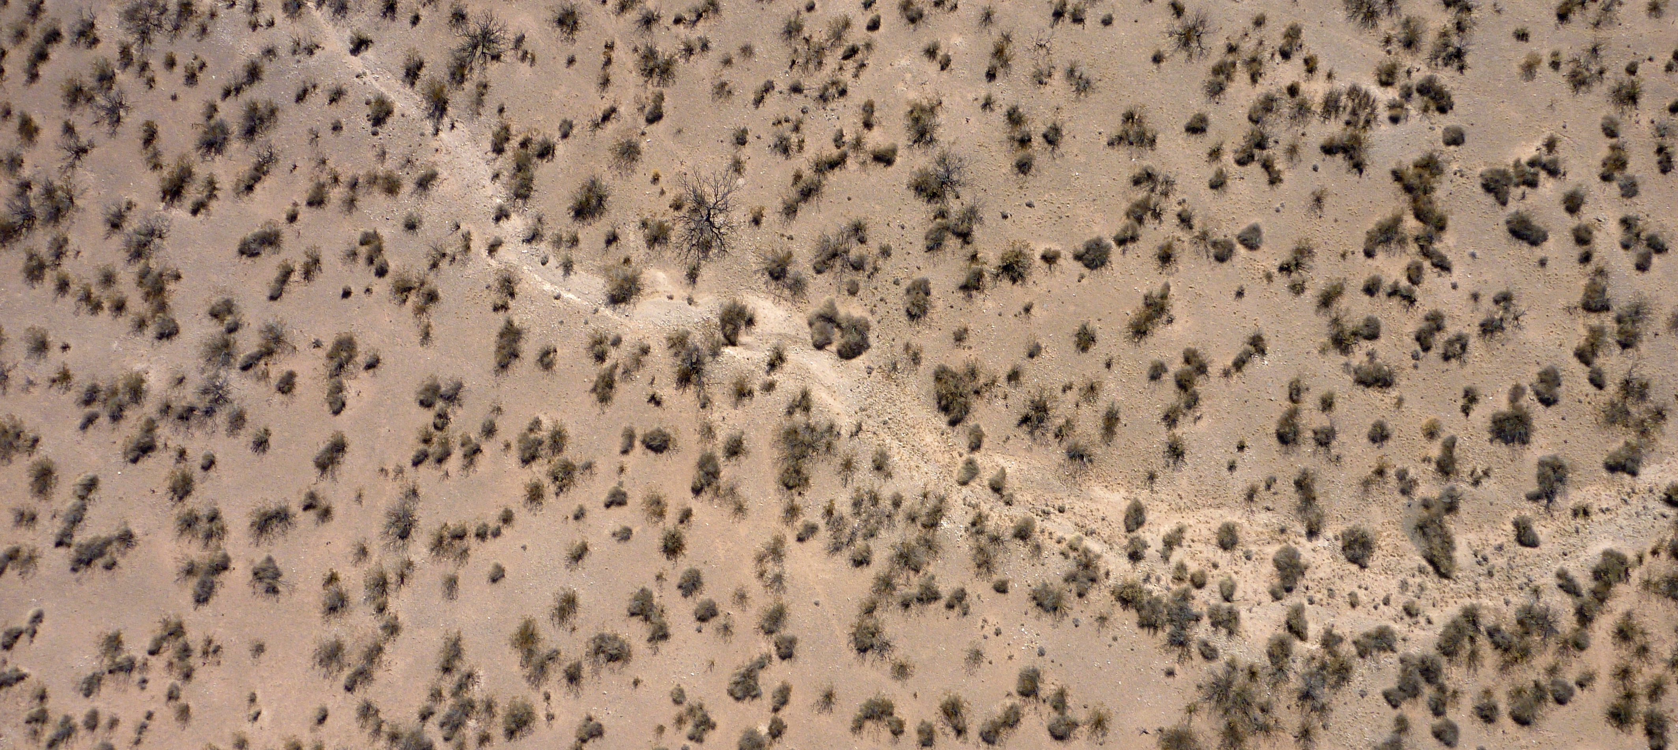
Implications of an Encroaching Desert Ecosystem
Sparse vegetation of the Chihuahuan desert
Dust storms containing allergens such as fungus
Sparse vegetation of mesquite shrubs leads to altered erosion patterns, creating an environment suitable for dust storms.
Notes:
Get high resolution pics from Fransca from viz wall. Get them from Frank ☺ Possible video, test to see if works. Be sure to give credit

Slide 7
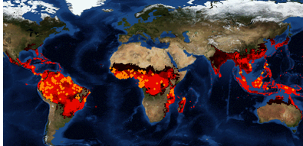

Species Distribution Modeling
Predictions: If we move to hotter climates with more variable precipitation, will we get further encroachment in the desert?
Will we get more erosion?
Will we get higher flood events?
Species Distribution Models (SDM) can provide insight:
“I want to model the transition from grassland to Chihuahuan desert during historic regions of drought”
Notes:
List all people at teams: lifemapper, edac, and UTEP. Include all people even non-authors. Introduce in the beginning with logos and picture of peoples.

Slide 8
Challenges: A Loaded Request
2
Denotes a duration of time encompassing a set of relevant environmental data
Data discovery, integration, transformation
1
These biomes are not defined solely by geographic coordinates; they are partially defined by its migrating flora (interpretation)
3
“I want to model the transition from grass lands to Chihuahuan desert (probably steppe), during historic periods of drought”
4
Drought denotes an event, that contextualizes a set of geospatial data within some space/time (interpretation)
Notes:
Identify the current and future work, perhaps by highlights. This is a work in progress, but we have some initial results for (1). This is achalleng that evolves but we are addressing the particular grant with was targeted with 1.

Slide 9
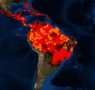
A Common Pattern of the Model Web
“…a system of interoperable computer models and databases communicating primarily via web services” – Geller 2009
Modeling Environment (WCS)
Web Client
Modeling Service (WPS)
Species Data
Data and Models exposed as services

Slide 10
Potential Limitations of the Model Web
- Where can I find relevant data?
- How do I know it is relevant?
Discovery Limitations
What transformations are required to satisfy requirements?
Web Client
Modeling Service (WPS)
Interface Requirement Disparities

Slide 11

Earth, Life, and Semantic Web
The goal of ELSEWeb is to streamline the flow of heterogeneous geographic, social, and geological data into Lifemapper modeling services
EDAC WCS Data
Semantic Metadata
Adapter KB
Orchestration Agent
Web Client
Lifemapper
(RESTFull)
Lifemapper Species Data
ELSEWeb Semantic Mediation Layer

Slide 12
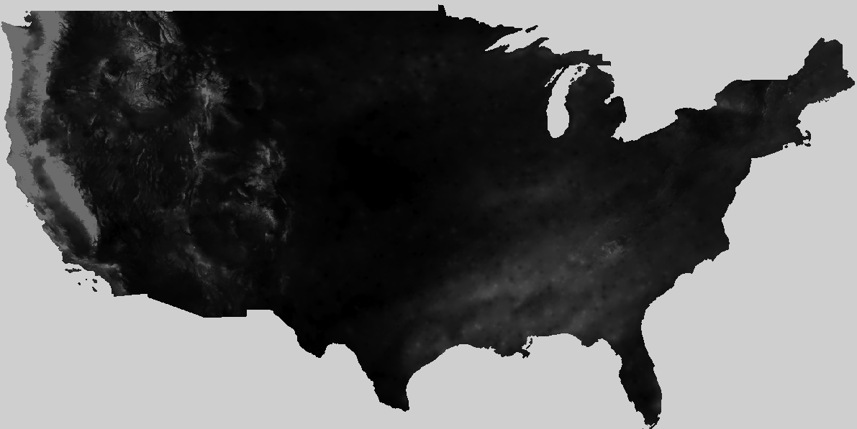
ELSEWeb Components
Metadata
OWL
Metadata
Individuals
EDAC Data
ELSEWeb Data
Selector Service
cardioSHARE coordinates execution of services to satisfy a query
ELSEWeb Adaptor Services
Adaptor Service 1
cardioSHARE + Pellet
Adaptor Service n
SADI Service OWL
Experiment Specifications RDF
Model Generation Query (SPARQL)
Lifemapper Service

Slide 13
Earth Data Analysis Center
CF Keywords
GCMD
Categories
WCS Get Capabilities
XML
FGDC XML
ISO
19115
Topic
Categories
Metadata Store
Harvest: translate metadata descriptions into our ELSEWeb data model
ELSEWeb Data
Data Store
WCS Data = Multipart MIME = Payload Tiff + Metadata

Slide 14
Desirable Data Model
What kind of data?
OBOE: Observation Ontology
Where can I get the data?
DCAT: Data Catalog Vocabulary
How was the data generated?
Who was responsible for publishing?
When was it generated?
PROV-O: Provenance Ontology

Slide 15
EDAC Semantic Data Model
dcat:dataset
dcat:distribution
Catalog
Dataset
Distribution
rdfs:subClassOf
dc:temporal
dc:spatial
PeriodOfTime
WCSCoverage
Location
oboe:ofCharacteristic
oboe:measurementFor
Characteristic
Measurement
Observation
DCAT
rdfs:subClassOf
oboe:ofEntity
OBOE
Activity
Entity
PROVO

Slide 16
Mapping CF to OBOE
CF vocabulary couples entities with measurements, so we need to decompose:
dew_point_temperature
Entity
Characteristic
Prepackaged with
OBOE.owl
Atmospheric Feature
Temperature
DewPoint
Need to reuse other ontologies such as SWEET to extend OBOE
An ELSEWeb extension

Slide 17
Describing Adaptors using SADI
Adaptor services perform operations such as:
Data selection – binds specifications to satisfactory data
Data transformations – transform structure or format of data
Modeling – implement modeling algorithm
Adaptor services are implemented as Semantic Automated Discovery and Integration Services:
outputParameter
ServiceDescription
Operation
Parameter
hasOperation
inputParameter
ELSEWeb Adaptor Services

Slide 18
An Example SADI Service: Extractor
Distribution
rdfs:subClassOf
elseweb:hasWCSCoverageDistribution 1..10
WCSCoverage
Distribution
WCSScenario
myGrid:inputParameter
rdfs:subClassOf
rdfs:subClassOf
SADI OWL
WCSPayloadExtractor
ELSEWeb OWL
myGrid:outputParameter
TiffExtracted
WCSScenario
Elseweb:hasExtractedTiffScenario
WCSPayload
18

